Slide 1
Wireless Sensor Network and Internet Protocol Integration with COTS
Sigit Basuki Wibowo
Widyawan

Slide 2
Outline
Introduction
Wireless Sensor Network
Gateway Design and Development
Conclusion
“Commercial, off-the-shelf (COTS) is a term for software or hardware, generally technology or computer products, that are ready-made and available for sale, lease, or license to the general public.”

Slide 3
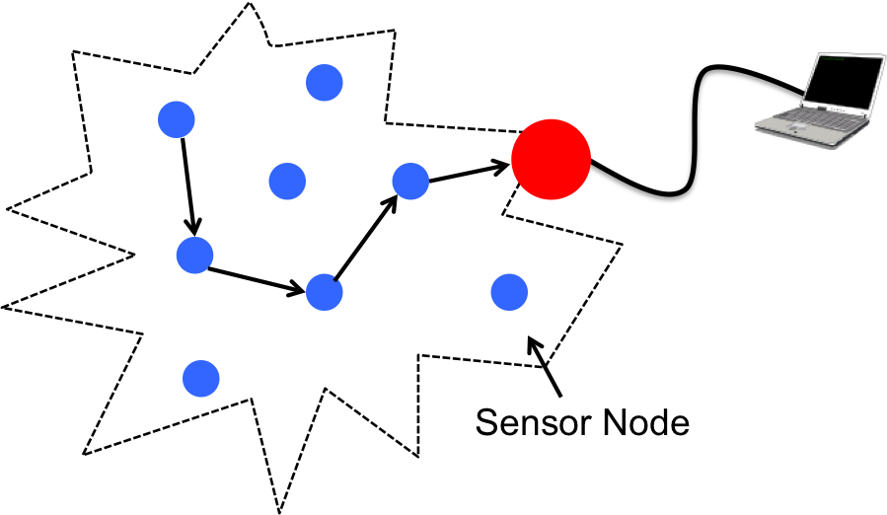
Wireless Sensor Network
Consists of hundreds to thousands of nodes
Needs management and monitoring
Internet → Solution for global service
Proxy based architecture
Sensor node IP stack

Slide 4
WSN and IP Integration
Gateway
Internet
TCP/IP
Network Transformation
WSN
Dedicated Protocol
Dedicated Protocol
Proxy-based architecture approach

Slide 5
WSN and IP Integration (Cont.)
WSN
Internet
Sink Node
IP Based
Sensor Node IP Stack based approach

Slide 6
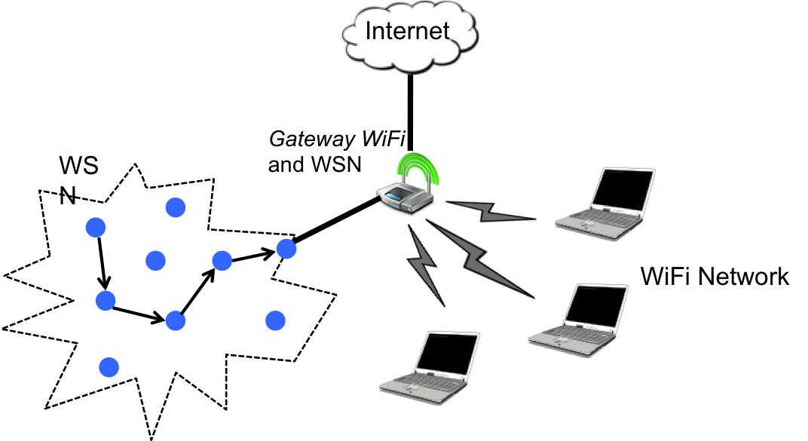
Internet Gateway
Gateway
Web Interface
Controller Apps.
OpenWrt OS
USB to Serial
Based on COTS device
Low cost
Interoperability
Sink Node

Slide 7
Controller Application
Controller Apps.
Open Serial Port
Get current option of
Serial Port
Web Interface
OpenWrt OS
Modify the option of
Serial Port
Save the option of
Serial Port

Slide 8
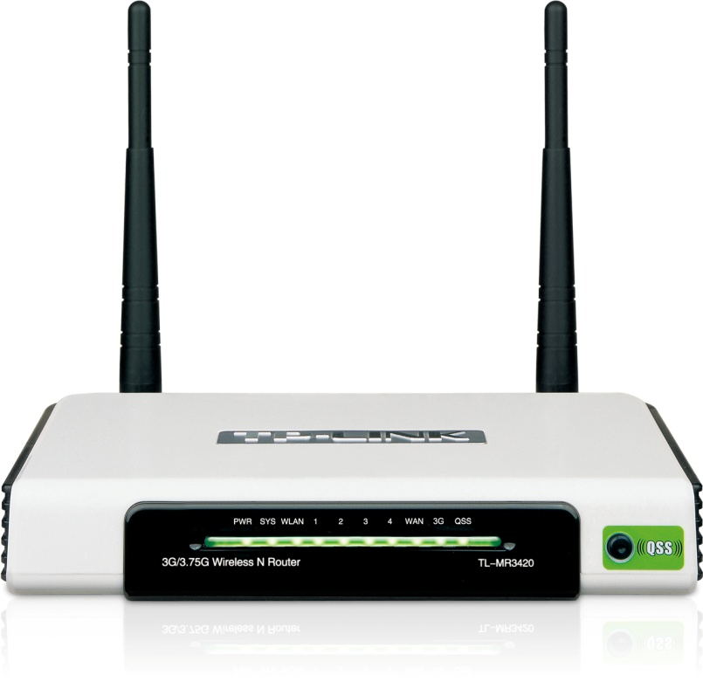
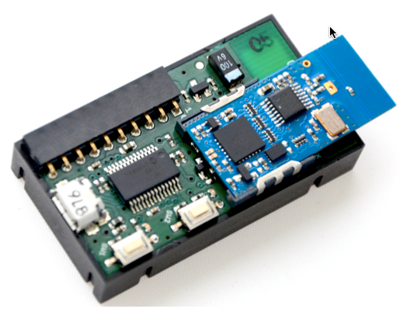
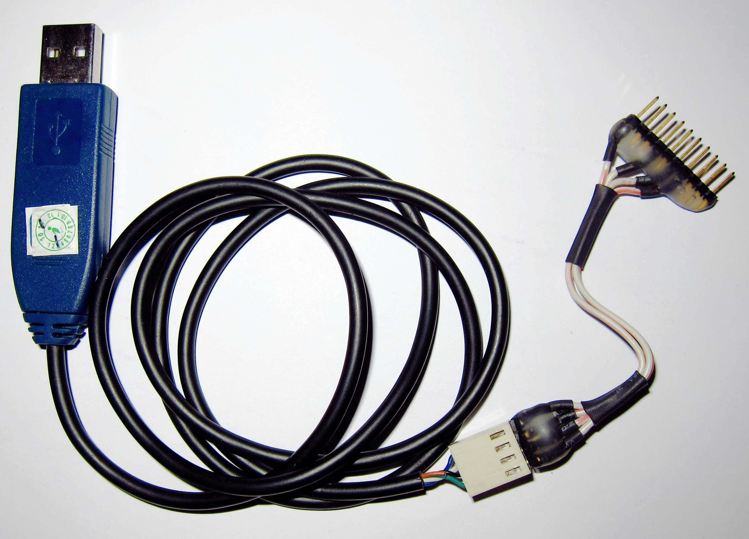
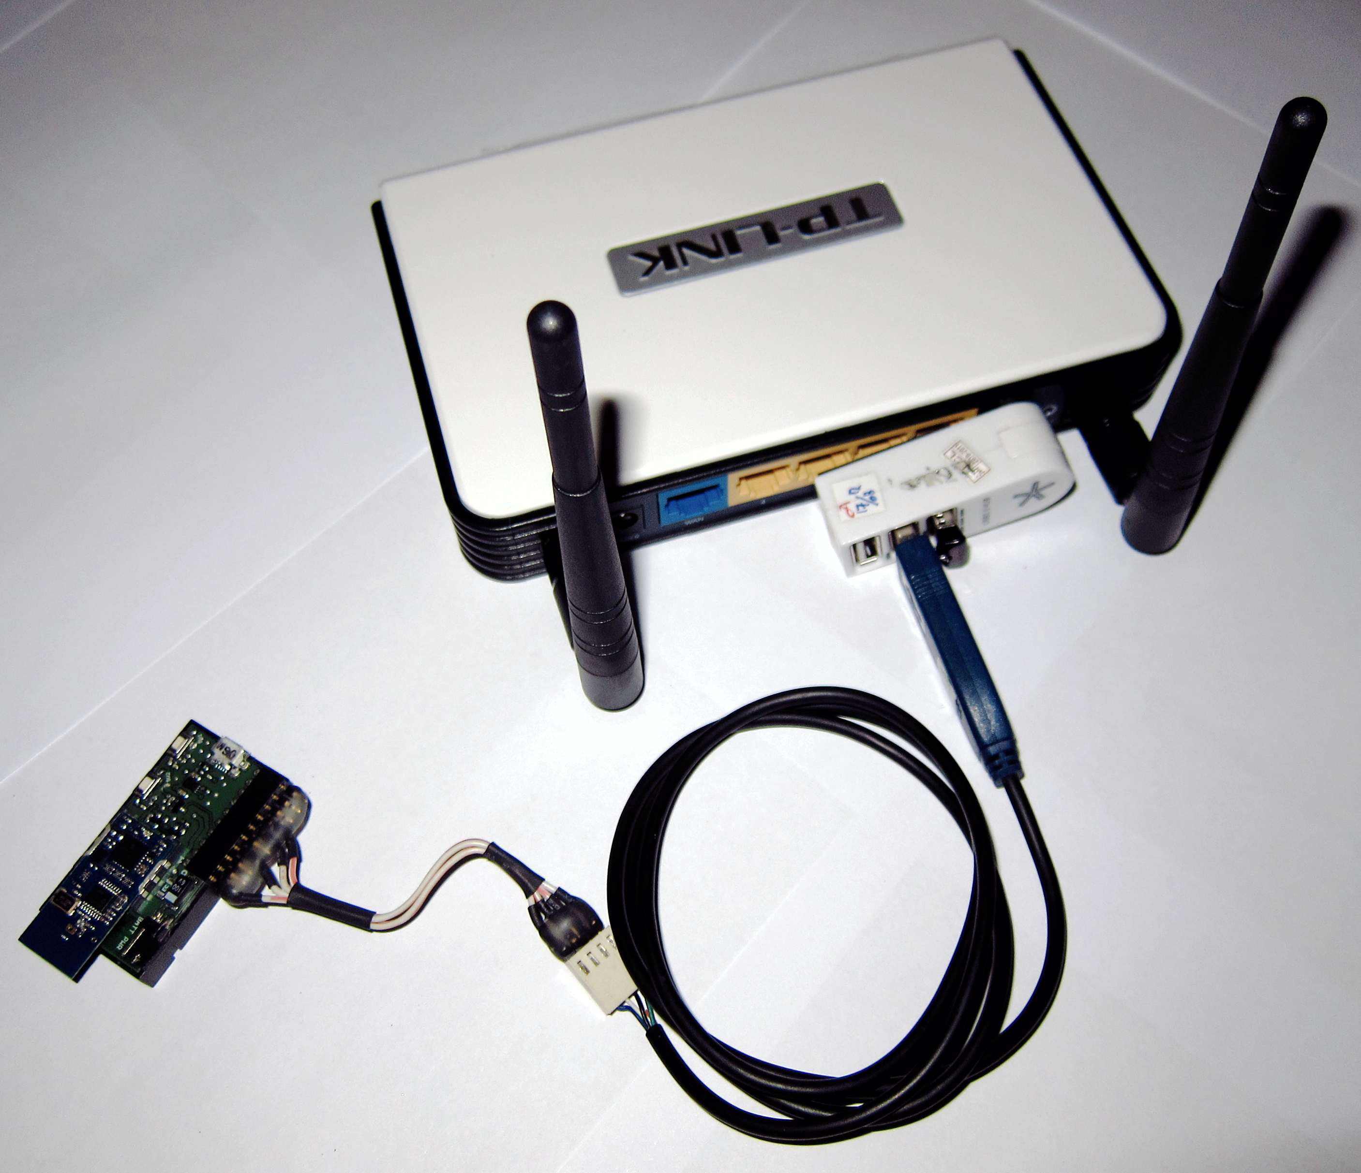
System Setup
COTS Access Point
IQRF Sensor Node
IQRF Devel. Kit
USB-Serial Converter
Custom OS (OpenWrt)
Increasing USB port number
Increasing the storage capacity

Slide 9
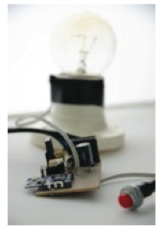
Result
Sink Node
I/O | Web Intr. | Output
Pin C1 | ON/OFF | 1/0
Pin C2 | ON/OFF | 1/0
Pin C6 | ON/OFF | 1/0
Pin C7 | ON/OFF | 1/0
Other Nodes
I/O | Web Intr. | Output
Pin C1 | ON/OFF | 1/0
Pin C2 | ON/OFF | 1/0
Pin C5 | ON/OFF | 1/0
Pin C6 | ON/OFF | 1/0
Pin C7 | ON/OFF | 1/0
Pin C8 | ON/OFF | 1/0

Slide 10
Conclusion
Gateway method is the easy solution for integration WSN and IP
COTS device may increase flexibility for adding the service software and in the same time reduce the cost
COTS reduce installation cost for already installed WSN
Increase system interoperability

Slide 11
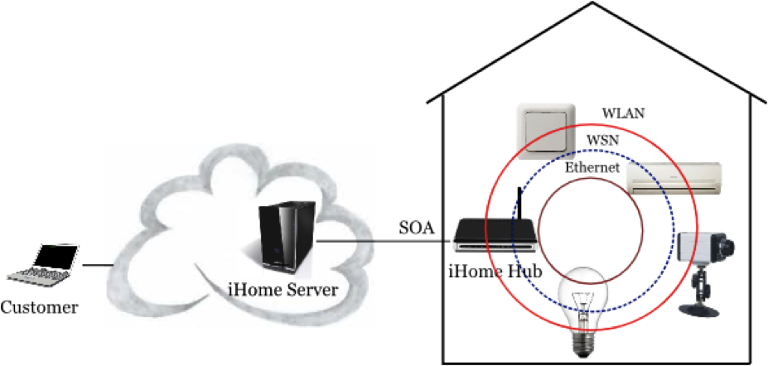
Next Work
Add more WSN paltform (e.g. Zigbee, Crossbow)
Integrate with smart home system
Add more services in the gateway

Slide 12
Thank You

